Slide 1
Sanctuary for families trafficking survivor intake clinic training
Akin Gump Straus Hauer & Feld LLP
January 16, 2025

Slide 2
OUR WORK
Sanctuary for Families serves victims of domestic violence, sex trafficking, and related forms of gender violence. Through comprehensive services for our clients and their children, and through outreach, education and advocacy, we strive to create a world in which freedom from gender violence is a basic human right.

Slide 3
What is Human Trafficking?
Notes:
According to UNOD

Slide 4
Globally
Trafficking generates approximately $150 billion annually (Sources: UN Office on Drugs and Crime, International Labor Organization)
Trafficking in persons is often referred to as one of the fastest-growing transnational organized crimes (UN)
Human trafficking is the second largest criminal enterprise in the world (UN)
Notes:
According to UNOD

Slide 5
UNITED NATIONS: Palermo Protocol
“Trafficking in persons” is the recruitment, transportation, transfer, harboring or receipt of persons, by means of the threat or use of force or other forms of coercion, of abduction, of fraud, of deception, of the abuse of power or of a position of vulnerability or of the giving or receiving of payments or benefits to achieve the consent of a person having control over another person, for the purpose of exploitation…”
Notes:
Convention against Transnational Organized Crime
The purposes of this Protocol are:
(a) To prevent and combat trafficking in persons, paying particular attention to women and children;
(b) To protect and assist the victims of such trafficking, with full respect for their human rights; and
(c) To promote cooperation among States Parties in order to meet those objectives.

Slide 6
u.s. Federal law: tvpa
Sex Trafficking
“the recruitment, harboring, transportation, provision, obtaining, patronizing, or soliciting of a person for the purposes of a commercial sex act, in which the commercial sex act is induced by force, fraud, or coercion, or in which the person induced to perform such an act is under the age of 18 years” * (Severe Form of Trafficking in Persons Definition in Bold)
Labor Trafficking
“The recruitment, harboring, transportation, provision, or obtaining of a person for labor or services, through the use of force, fraud, or coercion for the purpose of subjection to involuntary servitude, peonage, debt bondage, or slavery.”
22 U.S.C § 7102
Notes:
In 2000, Congress passed the landmark Trafficking Victims Protections Act (“TVPA”). With bipartisan support, the TVPA provided law enforcement with tools to investigate and prosecute incidents of human trafficking, and, among other things, services and immigration relief to victims of severe forms of human trafficking and certain close family members. Victims of Trafficking and Violence Protection Act of 2000.

Slide 7
Severe form of sex trafficking
Action | Means* | Purpose
Induce; Recruit; Harbors; Transports; Provides; Obtains; Patronizes; or Solicits | Force; Fraud; or Coercion | Commercial Sex (Sex Trafficking) or Labor/Services (Labor Trafficking)
* Individuals under 18 years old induced into providing commercial sex are human trafficking victims, regardless of force, fraud or coercion
Notes:
TVPA Sec. 103, within INA sec. 101(a)(15)(T), definition at 8 CFR 214.11(a) (definition of Severe form of trafficking in persons). See 3 USCIS Policy Manual B.2(B)(1): https://www.uscis.gov/policy-manual/volume-3-part-b-chapter-2

Slide 8
Dynamics of trafficking
Previous Arrest History
Lack of Education / Job Skills
Substance Use
Adverse Childhood Experiences
Promises of well-paid work
Poverty
Lack of emotional security
Push
Pull
Trafficker promises to provide whatever is lacking (housing, family, a job, emotional support, etc.)
Trauma early in life
Lack of financial security
Discrimination based on race, class, gender, gender identity or sexual orientation
Hopes of self-reliance
Trafficker presents opportunity to flee domestic violence or abuse
Isolation
Unstable housing & homelessness
No sponsor after immigration detention
Limited English

Slide 9
Power & Control Dynamics in Trafficking

Slide 10
Violence and abuse
“Looking at her body on the bed it was like she was dead . . . literally. Never seen someone lie so still before. There was NOTHING THERE! Haha.”
─Sex Buyer in Legal Australian Brothel
Jovanovski, N and Tyler, M. “Bitch, You Got What you Deserved!”: Violation and Violence in Sex Buyer Reviews of Legal Brothels (2018).
90% of survivors reported being physically assaulted; Over 50% of these survivors reported being beaten at least once a month.¹
94% of survivors reported being sexually assaulted; 75% had been raped by one or more buyers.²
95% had sustained head injuries, either by being hit in the head with objects and/or having their heads slammed into objects.³
80% reported being threatened with a weapon.⁴
Parriot, R. (1994). Women used In Systems of Prostitution Engaged in Revolt (WHISPER) & From Prostitution to Independence, Dignity and Equality (PRIDE). N=68
Miller, J., & Schwartz, M.D. (1995).
Farley, M., Banks, M.E., Ackerman, R.J., & Golding, J.M., (2018). N=66
Valera et. al (2001). N=100
Notes:
Rates : stories, torture; be prepared and able to hear this; listener abandonment: integrate role plays so folks can get practice hearing these things; we do a disservice by not talking about this authentically; if you can’t hear this; want folks to be realistic about what this work entails; have to be able to listen and hear- without alternatively demanding stories

Slide 11
Physical Impacts
95% reported that 1.5 years after leaving the sex industry, they still suffered from an injury received while being sexually exploited ¹
Malnourishment
Broken bones
Burns & stab wounds
Head injuries/Traumatic brain injuries
Autoimmune disorders
STIs
Dental trauma
Anogenital injuries (rectal prolapse/vaginal injuries)
Hip, neck, jaw, stomach pain
Internal injuries
Pregnancy-related issues
Physical developmental delays
Genitourinary complaints (discharge, pelvic/abdominal pain, abnormal bleeding)
Farley, M., Cotton, A., Lynne, J., Zumbeck, S., Spiwak, F., Reyes, M., Alvarez, D., & Sezgin, U. (1998). N=854

Slide 12
Social-Relational Impacts
Lack of trust in one’s own judgment
Hesitation to trust others
Lack of appropriate boundaries/quick attachment
Lack of interest in sexual relationships and/or difficulty with sexual interactions
Fragmented/no employment or educational history
Isolation
Trauma coerced bonding
Mistrust and suspicion of authorities and service providers

Slide 13
psychological Impacts
“At first it made me feel degraded but now I just switch off. Pretend I am not there.”
—Survivor*
Depression/mood dysregulation
Suicidality
Low self-esteem
Self blaming
Feelings of confusion or ambivalence
Difficulty concentrating/memory loss
Shame and embarrassment
Self-isolation
Poor eating, grooming, and self-care habits
Self-medication (Drug and alcohol use)
Multiple hospitalizations
Misdiagnoses
1. *Coy, M.(2009). This body which is not mine: The notion of the habit body, prostitution and (dis)embodiment”

Slide 14
Overview of T Nonimmigrant Status
Humanitarian remedy created in 2000 as part of Victims of Trafficking and Violence Protection Act (TVPA)
Provide 4 years of temporary immigration status to immigrant victims of “severe forms” of human trafficking
Provides pathway to permanent residency
Encourages immigrant victims to report crimes and seek protection of law enforcement
Adjudicated by a specially-trained officers at USCIS

Slide 15
Eligibility for T Status INA 101(a)(15)(T)
1. Victim of “severe form” of trafficking (sex or labor);
2. Present in the US “on account of” trafficking;
3. Either (a) complies with reasonable requests for assistance by law enforcement officials or (b) is unable to cooperate due to physical/psychological trauma or (c) is under 18; and,
4. Would suffer “extreme hardship” if deported.

Slide 16
Present “On Account of” Trafficking
Victims must explain how their presence in the United States at the time of application is connected to the trafficking.
Is present because:
he or she is actively being trafficked;
was recently liberated from a severe form of trafficking in persons; or
was subject to trafficking in the past and remains in the US for reasons directly related to the original trafficking in persons.
USCIS will take into account the individual petitioner’s circumstances, including “trauma, injury, lack of resources or travel documents that have been seized by the traffickers.” 8 CFR § 214.11(g)(2).

Slide 17
Cooperation with Law Enforcement
Generally must either report the trafficking to law enforcement or have responded to inquiries from law enforcement. 8 CFR § 214.11(f)(4).
Must comply with all “reasonable” requests for assistance;
I-914 Supp B is primary evidence of cooperation;
Where no I-914 Supp B is available, must present credible secondary evidence of cooperation.

Slide 18
Would Suffer Extreme Hardship If Deported
Need not be related to the trafficking
Can include :
Age or personal circumstances;
Need for medical or psych health care;
Impact of loss of criminal justice system;
Unwillingness of foreign authorities to protect victim;
Likelihood of retaliation by trafficker;

Slide 19
Inadmissibility
INA §212(a) lists grounds of inadmissibility
Waivers of grounds of inadmissibility can be filed per INA §212(d)(13) for T petitioners
Public charge grounds do not apply
Waiver requested by filing Form I-192
Common Grounds:
Entry without inspection
Lack of valid passport
Involvement in prostitution

Slide 20
Trauma informed representation

Slide 21
TRAUMA-INFORMED LAWYERING
What is trauma-informed lawyering?
Individualized practice approach
Informed by client’s trauma
Flexible
Supportive
Strives to avoid re-traumatization
Notes:
JESS What is trauma-informed lawyering?
Informing and adjusting your practice approach based on each client’s unique trauma experience and trauma symptoms.
Trauma-informed lawyering should support the client’s trajectory of healing and resiliency.
Ameliorate the perpetrator-victim dynamic:
Empowerment & connection vs. disempowerment and disconnection

Slide 22
Trauma-informed lawyering
Why Is Trauma Informed Lawyering Important?
Rule 1.1 of the NY Rules of Prof. Conduct requires that attorneys “provide competent representation”, which includes “the legal knowledge, skill, thoroughness and preparation reasonably necessary for representation”.
Developing TIL skills is critical to ensuring competent and successful representation of trauma victims.
Provide dignified, respectful and compassionate representation.
Notes:
JESS

Slide 23
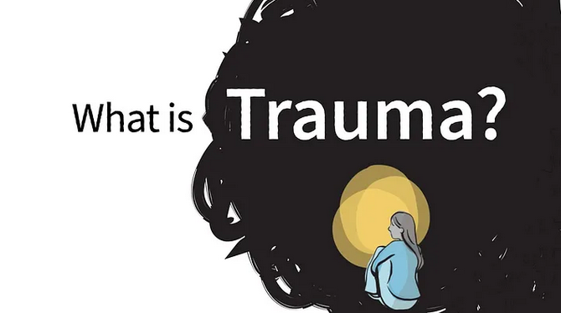
UNDERSTANDING TRAUMA
Trauma refers to experiences that have caused intense physical and/or psychological stress reactions.
Single event, multiple events, and/or a set of circumstances
Systemic trauma will often be part of your client’s experience (e.g., racism, sexism)
Notes:
NICOLE

Slide 24
NEUROBIOLOGY OF TRAUMA
Frontal Cortex
Thoughts
Executive functioning
Language
Adaptive learning
Mammalian brain
Brainstem (Reptilian brain)
Instincts
Heart rate
Breathing
Impulses
Limbic System
(Mammalian brain)
Emotions
Non-verbal
Relational experiences
Images
Notes:
NICOLE

Slide 25
TRAUMATIC MEMORIES
Traumatic memories are not stored in the “thinking” part of the brain (frontal lobe), they are stored in the limbic system
“Fight, flight, or freeze” part of the brain
Farthest region from speech/language production
Responsible for non-verbal emotion
Sensory imprints
Notes:
NICOLE

Slide 26
TRAUMATIC MEMORIES
What does that mean?
Survivors recall their reactions to the traumatic event—images, sensations, fear, stress
Difficult to verbalize the memories
Difficult to contextualize the trauma within the past, present and future
Difficult to accurately recall details like names, dates, times, places
Notes:
NICOLE

Slide 27
MANIFESTATIONS OF TRAUMA
Physical, Relational, Psychological
Flooding / Flashbacks | Minimization | Dissociation
Difficulty trusting others | Shame and embarrassment | Lack of trust in one’s own judgement
Depression, anxiety, and/or low self-esteem | Self-blaming | Anger
Nightmares/lack of sleep | Trauma-bonding | Drug and alcohol use
Notes:
NICOLE

Slide 28
FLOODING
Memories flood all at once
Unable to stop themselves from talking
Client moves back and forth between different traumatic experiences
Can’t construct a chronological narrative
Possible flashbacks
Notes:
NICOLE

Slide 29
HOW TO HELP YOUR CLIENT THROUGH A DIFFICULT PART OF THEIR STORY
Grounding: Bring your client back to the present
Gently stop client
Pour some water or tea
Walk outside for fresh air
Walk client to the bathroom
Encourage client to take deep breaths
Ask neutral questions (e.g., plans for after they leave the office, the weather, etc.)
Client may have their own grounding tool
Notes:
NICOLE

Slide 30
MANIFESTATIONS OF TRAUMA
Minimization
Survival mechanism
Diminish or deny the intensity of traumatic events
Disconnects emotional response from content
Result
Minimize harm (“not as bad as it could be”) or omit important traumatic events
Flat affect; no emotion, no tears
Notes:
NICOLE

Slide 31
Screening & Intake

Slide 32
How can you practice trauma informed screening?

Slide 33
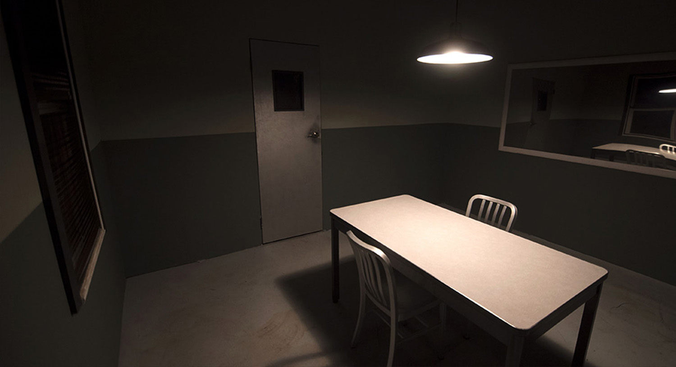
SETTING THE STAGE: CREATING A SAFE SPACE
Notes:
JESS
Virtual-Specific
Get camera consent in advance
Talk about children in advance – they should not be in the room!
Consider your space and what the client will see

Slide 34
Collaboration & Transparency
Notes:
JESS

Slide 35
Mitigate power differential

Slide 36
INTERVIEW WITH A TRAUMA-INFORMED APPROACH
Use open-ended questions
Try not to interrupt too much (unless client is flooding)
Record your questions and go back later to ask clarifying questions
Ask only what you need to know
Ex: Name change case vs. asylum case
Be careful with labeling
Trafficked, raped, persecuted
Mirror client’s language
Notes:
JESS

Slide 37
More Interview tips
Non-judgmental and non-victim blaming questions
Don’t ask questions that presume a right or wrong way of doing things.
Ex: “Why did you wait so long to come forward?” “Tell me about your decision to seek help from the police.”
Use context to build a timeline
How old was your son?
What was the weather like?
Was it near a holiday?
Don’t force details
May need to use creative lawyering (e.g., evidence-based cases, etc.)

Slide 38
DISCUSSING SENSITIVE TOPICS
Provide a warning before jumping into a difficult topic
Explain WHY the question is necessary to the legal case
Don’t express entitlement to information (trust must be earned!)
Monitor your client’s reactions
Monitor your own reactions
Be comfortable with silence as things are remembered
Leave the door open for other things to be shared later (if possible)

Slide 39
HOW TO HELP YOUR CLIENT THROUGH A DIFFICULT PART OF THEIR STORY
Strength-based perspective
Ex: “It took incredible courage to reach out for help”
Be compassionate (“I’m so sorry that happened”) but avoid anything that makes your client seem damaged or fragile (“you poor thing”; “I’ve never heard something so horrible”)
Do not engage in physical contact
Notes:
JESS

Slide 40
ENDING INTERVIEWS
Grounding is important at the end of the meeting
Never end the interview right after a re-telling of a traumatic event
Bring the client back to the present with neutral questions
Thank them for sharing their experience with you and remind them that everything they shared will remain confidential
Notes:
NICOLE

Slide 41
PROVIDER WELLNESS

Slide 42
Service provider wellness
VICARIOUS TRAUMA | Occurs due to continuous exposure to victims of trauma and violence. Exposure to the trauma of others has been shown to change the world-view of service providers and can put people and organizations at risk for a range of negative consequences.
SECONDARY TRAUMATIC STRESS (STS) | Refers to the natural consequent behaviors and emotions that often result from knowing about a traumatizing event experienced by another and the stress resulting from helping, or wanting to help, that person. Its symptoms can mimic those of posttraumatic stress disorder.
Notes:
NICOLE

Slide 43
Service provider wellness
Red Flags
Mimic manifestations of trauma
Higher levels of anxiety, stress, or depression
Intrusive and/or persistent negative thoughts or feelings
Guilt, shame, self-doubt – “I can never do enough”
Avoidance and withdrawal
Hyperarousal & hypervigilance
Sleep disturbance
Negative coping mechanisms (e.g., excessive drinking, isolation)
Important to recognize and understand personal red flags
Notes:
NICOLE

Slide 44
Service provider wellness
Taking Care of Yourself
Acknowledge when you are struggling
Practice self-compassion
Build support system / seek out supportive relationships – do not go it alone!
Set personal boundaries with clients and colleagues
Create a self-care plan in advance and execute when notice red flags
Cultivate vicarious resilience through your work with survivors and/or your community
Notes:
JESS

Slide 45
QUESTIONS?

Slide 46
We are here for you!
Jessica-Wind Abolafia jabolafia@sffny.org
Whitney Hood whood@sffny.org

Slide 47
Disclaimer
This presentation was last updated on January 14, 2025 by Sanctuary for Families. It contains no personally identifiable information. This presentation is intended for training and reference only. It should not be solely relied on for the current law, or policy and procedures of any government entities and Sanctuary for Families. This presentation may not be distributed without the written permission of Sanctuary for Families.

