Slide 1
PETITIONER DRAFTING CLINIC: CUSTODY/VISITATION
Presented by:
Taylor L Craney, Esq and Laurence Waucampt, Esq
Sanctuary For Families, CBWLS Consultation Attorneys, Family Law Project
1
Notes:
1

Slide 2
AGENDA
Introduction to Sanctuary for Families/Family Justice Centers
Custody/Visitation Legal Standard
Types of Custody
Legal
Physical
Typical Lifecycle of a Custody/Visitation Case
Petition Drafting 101
Your Custody Petition Clinic Day
Working with Survivors 101
Questions

Slide 3
INTRODUCTION TO SANCTUARY FOR FAMILIES
Sanctuary for Families is a non-profit organization serving survivors of domestic violence, trafficking, and other forms of gender-based violence
Pillars of Service:
Legal
Clinical
Shelter and housing
Economic empowerment through educational assistance and workforce training programs
Direct financial grants

Slide 4
INTRODUCTION TO SANCTUARY FOR FAMILIES Legal Department
About 100 staff members within the Legal Department
Projects within the Legal Department
Family Law
Matrimonial
Housing and Public Benefits
Immigration
Anti-Trafficking
Tech Abuse Clinic
Small Claims Court Project
Incarcerated Gender-Based Violence Survivors Initiative
Pro Bono Project
Pro Bono Work
Law firms donated 69,638 pro bono hours in FY 24-25. The aggregate value of donated pro bono services totals $67.8 million.

Slide 5

Family Justice Centers (FJC)
One in each of the five boroughs
“One-stop shop” concept
Co-locates key city agencies, community, social and civil legal services providers, and District Attorney's Offices to make it easier for survivors to get help.
Survivors of gender-based violence and their children who go to the FJC in their borough can get case management, economic empowerment, counseling, civil legal, and criminal legal assistance all in one place – even though that assistance may be provided by different organizations providers
Sanctuary now provides family law legal services in all five FJCs

Slide 6
PETITION DRAFTING CLINIC PURPOSE
Many survivors get legal screenings at the FJCs and need help starting a family court case.
Significant need to assist these survivors with pro se petition drafting so that they can start their cases off on a strong footing.
Pro bono attorneys, under Sanctuary's supervision, can greatly increase the FJC’s ability to assist survivors, whose cases we cannot take for direct representation, with relatively straightforward family law-related legal documents like those required for custody cases.

Slide 7
CUSTODY AND VISITATION 101

Slide 8
CUSTODY/VISITATION: MYTHS v. FACTS
MYTHS
Abusers never get custody
If a survivor does not want their child to see the abuser, the child does not have to attend visitation
Many abusers have no visitation with their children
The court system will agree with the survivor
Judges believe all allegations of domestic violence
A survivor can flee without their children and go back and get them any time they want
FACTS
Abusers who seek custody obtain custody in more than 50% of court cases
Some form of visitation is almost always granted
The parent’s wishes on visitation are not a paramount concern
Judges do not believe everything a survivor says just because they are the survivor
The parent who has physical custody when he/she walks into court often maintains physical custody during the case
8
8
Notes:
8

Slide 9
Jurisdiction of Different Courts
 | OP | Custody/Visitation | Support | Divorce
Family Court | X (civil) | X | X
Supreme Court | X | X | X | X
Criminal Court | X (criminal)
IDV | X | X |  | X

Slide 10
What is a Custody Case?
Colloquial term “custody cases” includes:
Petitions for Custody and
Petitions for Visitation
Custody Petitions ask the court to grant decision-making rights, while Visitation Petitions ask the court to order a visitation schedule
Applicable Law:
Family Court Act (FCA), Article 6.
Domestic Relations Law (DRL), 240

Slide 11
Who can file for custody?
In general, only a child’s parents can file Petitions for Custody or Visitation.
It is necessary to show that the Respondent is also the child’s parent
Acknowledgment of Paternity
Respondent’s name is on the child’s Birth Certificate
Parties were married at the time the child was born
There is a Court Order showing proof of Paternity
In some cases, grandparents or other guardians can also file for custody
Applicable law
FCA § 651

Slide 12
Where can you file for custody?
Where the child lives.
The last county where the child lived for 6 consecutive months or, if the child is less than 6 months old, where the child has primarily lived.
If there is already a Custody Order in place, a Petition must be filed in that county.
If there is already a Family Offense Petition pending, a Petition may be filed in that county.
Client safety
Address confidentiality
Choice of venue

Slide 13
Best Interest of the Child
DRL § 240 – factors relevant to a custody determination
Domestic violence
Child abuse
“Such other facts and circumstances as the court deems relevant” in determining the BEST INTEREST OF THE CHILDREN STANDARD
Best Interest of the Child
Primary care taker
Continuity of care
Ability to provide emotional health and material well-being
Daily life, daycare arrangements
Avoid separating siblings among the parents
Quality of parental environments (might be bad for a poor woman in shelter)
Child’s preferences (weighs more heavily the older the child is)
Fitness of parent (drugs/alcohol, prison background)
Ability of one parent to encourage a positive relationship with the other parent “alienation”

Slide 14
Best Interest of the Child
Parent and child share reciprocal affirmative right to a relationship
This is a constitutional right
This presumption is very challenging to rebut
Factors considered:
Danger to child
Drug use
Violence – usually toward the child (DV to the other parent alone may not enough to prevent visitation)
“Emotional Damage” (must be very severe and litigated)
Case law- seminal case still: Eschbach v Eschbach, 56 N.Y.2d 167, 171 (1982); Friederwitzer v Friederwitzer, 55 N.Y.2d 89, 95 (1982)

Slide 15
Types of Custody
PHYSICAL/ RESIDENTIAL CUSTODY
Whoever has physical/residential custody is responsible for the actual physical care and supervision of a child. If the Judge gives sole physical custody, the child lives with this adult more than 50% of the time and this person is the custodial party and the noncustodial party will have visitation
If the Judge gives joint physical custody, the child lives with each parent for an equal amount of time.

Slide 16
TYPES OF CUSTODY
LEGAL CUSTODY
Sole legal custody means the custodial parent has the legal authority to make all decisions in the child’s life - educational, medical, religious, etc.
Joint legal custody means the custodial parent must discuss all major decisions in the child’s life with the other parent and cannot make a decision without the other parent’s consent.*
* Unless a parent has been granted “final decision making authority by the Court.”

Slide 17
Types of Visitation
Supervised visitation
Sandwich visits
Day visits lasting a few hours
Overnight visits
Several consecutive overnights
Where there is a domestic violence history, the court will often begin with supervised visits and expand, as long as the visiting parent doesn’t mess up. Supervised visitation is normally time limited.
Notes:
A finding of domestic violence must also be considered in determining a child’s best interest. See N.Y. Dom. Rel. Law § 240.
Domestic violence can be psychological in nature, such as derogatory language and threats by one parent against the other. See J.D. v. N.D., 170 Misc. 2d 877, 882 (Fam. Ct. Westchester Cty. 1996).
Even where acts of domestic violence occurred or outside of the child’s presence, that conduct nonetheless be demonstrative of the parent’s relative fitness to parent. See Matter of Felty v. Felty, 108 A.D.3d 705, 707-08 (2d Dept. 2013).

Slide 18
Lifecycle of a custody/Visitation Petition
Process can take years
File Petition (or Cross-Petition)
If there is an emergency, a Writ of Habeas Corpus or Order to Show Cause can be filed
Serve Petition and Obtain Affidavit of Service
First court appearance
Attorney for the Child is assigned if child is old enough
Temporary parenting schedule is sometimes put in place
Court Ordered Investigation may be ordered
Forensic evaluation (if ordered)- completed by a psychologist
Settlement negotiations (and possible comprehensive settlement)
Limited discovery to obtain certified records for trial
Trial

Slide 19
FILING A CUSTODY CASE

Slide 20
FILING FOR CUSTODY/VISITATION
IN-PERSON
Client goes to Family Court, provides their Petition to the Clerk
Will get a Summons and their filed Petition. The First date will most likely be a couple months out.
Must have the other party served
Police/Sheriff will not typically serve for free unless also serving an OP
REMOTE
File via NYSCEF
Client must create their own account.
Will take a couple days/weeks to get a summons- this is normal.
20
20
Notes:
20

Slide 21
THE PETITION
What to Plead?
SOLE CUSTODY!
Unless the client is extremely insistent, always ask for sole custody in the court papers – this established the broadest legal claim on behalf of the client and the child’s best interest.
Joint custody is generally a bad situation for parents who have historically had a relationship defined by bullying, abuse, and a power and control dynamic. Joint decision-making opens the door to continued abuse.
21
21
Notes:
21

Slide 22
THE PETITION
Substance of Petition:
A Petition for Custody or Visitation is mostly facts about the client, the Respondent, or the child. There is one section in which to include the Petitioner’s requests and any background relevant to a judge’s determination of best interest of the child. Include:
Domestic violence history, or Family Offense Petition, if already filed or drafted
Focus on, if any, violence to the child/children or in front of the child/children.
Primary caretaker history
Drug abuse history
Time since Respondent has seen the children, or typical visitation schedule.

Slide 23
EVIDENCE FOR A CUSTODY CASE
History of Domestic Violence
Medical Records
Photographs/Screenshots of Injuries
Damaged Property
Third-party Witnesses
Respondent Admissions (recordings, text messages, email etc.)
Criminal Convictions
School attendance records.
Child’s medical history showing client as primary caretaker.
Testimony of neighbors, family, etc.

Slide 24
SERVICE
Must be completed at least 8 days before the court appearance date listed on the Summons.
Personal Service on the Respondent
Any time of the day
Any day of the week
Methods of Service
Sheriff (recommended)
Anyone over the age of 18, not a party.
Process Server
Alternative Service
Must have Court permission
Email/text

Slide 25
EXAMPLE PETITIONS

Slide 26
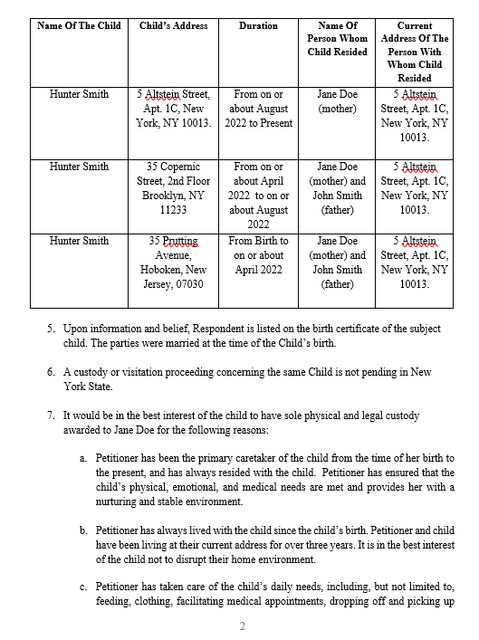
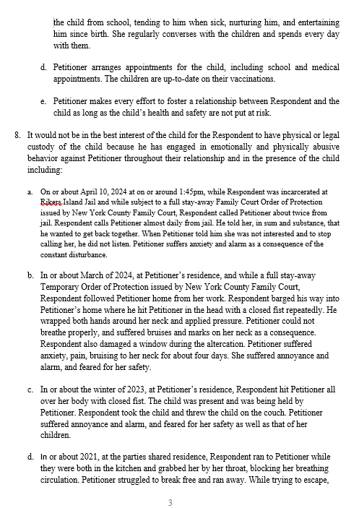
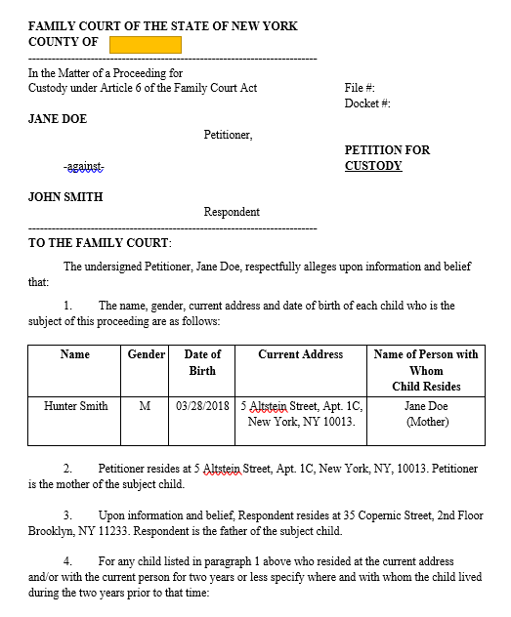
Example Custody Petition

Slide 27
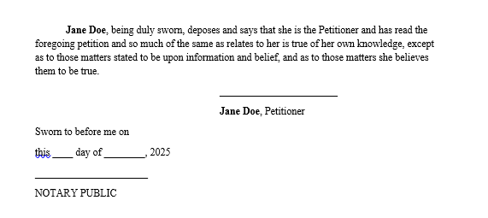
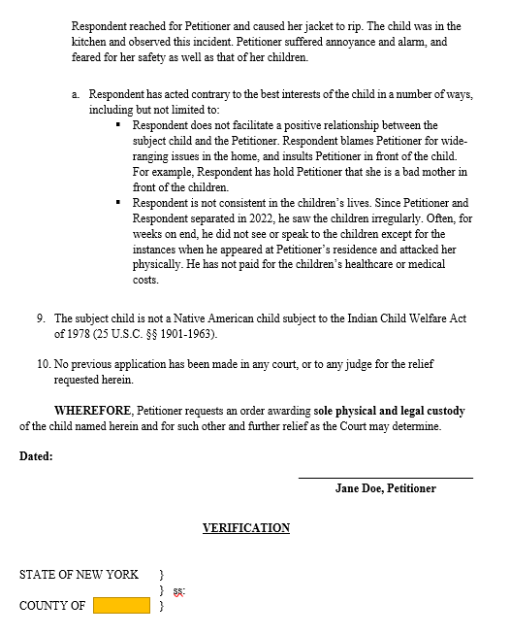
Example Custody Petition

Slide 28
Elements of a custody Petition
Petitions should be around 3-6 pages
Name and address of client
Unless client is requesting address confidentiality
Basis for requesting paternity- how was paternity established?
History of Address- jurisdiction/venue
Name and DOB of child

Slide 29
Elements of a custody Petition
History of DV- FOP
Best interest of the child
Information
Child subject to ICWA?
That’s it!

Slide 30
FINAL THOUGHT
The Initial Custody Petition is a legal framework- not a final parenting plan. It is also not the litigation of the client’s case.
It’s the client’s opening move, designed to lay out a clear, strong case and give the court a solid foundation.
It should establish a clean factual record, avoid unnecessary narrative, and position the client’s case clearly within the best interest of the child framework

Slide 31
CLINIC: THE DAY OF

Slide 32
CLINIC ORGANIZATION & STEPS
Clients comes into one of the five (5) citywide FJCs and receives a Civil Legal Screening from a Sanctuary attorney (the “Screening Attorney”).
If client needs help with Custody, the Screening Attorney will assess for Clinic eligibility and then ask Client if they consent to participating in the Clinic.
Sanctuary schedules client for one of the Clinic dates.
Sanctuary sends referral information to firm, including any relevant documents provided by the client.

Slide 33
Clinic Day 9:00am-3:00pm
By volunteering you are agreeing to be available during the ENTIRE time period
Your work might end before 3:00pm, but that cannot be guaranteed so please do NOT schedule other meetings or client calls during the clinic time.
Clinic is IN PERSON.
Three clients scheduled in total. Pro Bonos are put into pairs.
Sample Schedule:
9:00 am: pro bono attorneys who signed up shall arrive starting at 9:00 am. Supervising Sanctuary attorneys meet with pro bonos.
9:30 am: Clients arrive
9:30 am-10:00 am: Teams begin working with their clients and drafting documents. Supervising Sanctuary attorneys are available for questions.
12:30 pm: Ideally, client’s interview and initial draft is complete by pro bonos and sent to Sanctuary supervising attorneys.
12:30 pm-1:30 pm- Sanctuary attorneys review petitions.
1:30:00 pm-3:00 pm- Petition edits are made and Petition is filed.

Slide 34
Clinic Days Goals: Draft, File, Advise

Slide 35
CLINIC DAY GOALS
DRAFT
Teams will complete the following documents for ALL clients:
Client initiating any Custody Case:
Initial Petition
Personal Information Form
Teams will complete the following documents if needed for specific client:
Address Confidentiality Request
If client wants address kept confidential and is not already enrolled in NYS Address Confidentiality Program.
Attach any relevant documents (such as proof of paternity or an FOP)

Slide 36
CLINIC DAY GOALS
FILE
Teams will electronically file all Petitions via NYSCEF.
Filing steps included on the Portal.
There may be circumstances where the client will not want to file the same day, which is completely up to them.

Slide 37
CLINIC DAY GOALS
ADVISE
Explain to the client the basic outline of their litigation process
File
Serve
Return of Process
Hearing or Settlement
Order
Discuss summons
Discuss service
Make sure the client has Sanctuary’s contact information for follow up questions.

Slide 38
FAQ

Slide 39
FAQS
What if the client does not show up?
A. All the clients have agreed to the clinic date and have received reminders of the clinic date, so hopefully you won't have many instants where clients don’t show up. However sometimes clients don’t show up or cancel last minute/ the morning of. We try our best to make sure clients do show up, but cannot promise such.

Slide 40
FAQs
Q. What if my client asks me for advice or help with something other than the custody case?
A. Do not attempt to provide any advice on anything other than the custody issues on which you have been trained. Even if you believe you know the legal answer there are often safety concerns that we have to take into consideration before advising a client. Please be sure to detail the client’s legal question to your supervising Sanctuary attorney and let the client know that you will inform Sanctuary about their needs/questions.

Slide 41
FAQS
Q. How long should my meetings with the client be?
A. Ideally, you will have your first draft completed by 12:30pm and sent to your Supervising Sanctuary attorney(s). However, it can be hard to predict how long the meeting will take and depends on the type of assistance the client needs and whether their custody information is straightforward or requires a little more attention and inquiry.

Slide 42
THE PRO BONO PORTAL
https://sanctuaryforfamilies.org/pro-bono-resources/
Please request access to the Pro Bono Portal BEFORE your clinic date to ensure you have access to all the materials
The portal contains all of the manuals, templates, and instructions you might need to have handy
After you log in, search the Resources for “Pro Se” and click “Pro Se/Custody Petition Drafting Clinic” to find the clinic’s main site

Slide 43
WORKING WITH CLIENTS

Slide 44
WHAT IS DOMESTIC VIOLENCE?
Domestic violence is a form of gender-based violence that includes, a “pattern of intentionally violent or controlling behavior used by a person against a family member or intimate partner to gain and maintain power and control over that person, during and/or after the relationship.”
Compass Center for Women and Families

Slide 45
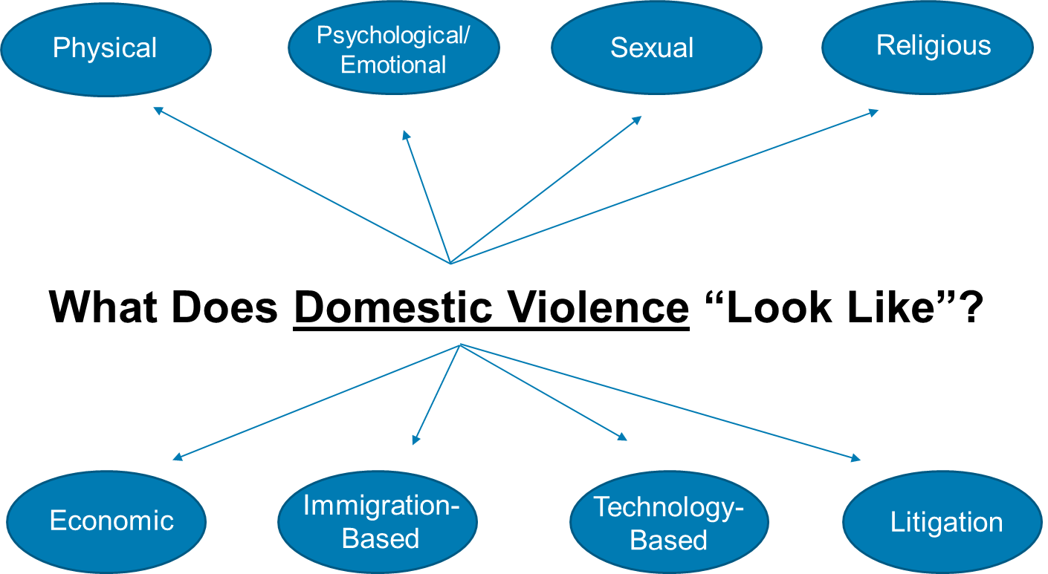

Slide 46

POWER AND CONTROL WHEEL

Slide 47
What Do Domestic Violence Survivors Look Like?
Gender Ethnicity Socioeconomic status
1 in 4 women and 1 in 9 men experience severe intimate partner physical violence, sexual violence, and/or stalking.
African-American women have a 35% higher rate of IPV than white women, and 2.5x that of women of other races.
Women in the lowest income households have 7x the rate of abuse of women in the highest income households.
Anyone can be a survivor of domestic violence.
Age Ability Sexual Orientation
Women ages 16-24 are most at-risk for experiencing sexual assault and those 20-24 years of age are at the greatest risk of nonfatal intimate partner violence.
Women with disabilities are 12.1% more likely to have experienced intimate partner violence as compared with those without disabilities.
Domestic violence occurs in LGBTQ relationships at similar or higher rates than in heterosexual ones.

Slide 48
Addressing Common Assumptions through Cultural Awareness
Cultural competence includes four elements:
1) Awareness of one's own cultural worldview,
2) Attitude towards cultural differences,
3) Knowledge of different cultural practices and worldviews, and
4) Cross-Cultural Skills, which involves developing an ability to understand, communicate with, and interact effectively with people across cultures.
Check any assumptions you may make about a Petitioner’s appearance, background, demeanor, or presentation.
Do not assume that you can identify a Petitioner’s sexual orientation or gender identity.

Slide 49
Identifying Misconceptions
Misconception: If you are really scared about your safety, you call the police.
Misconception: If you are abused by an intimate partner, you leave the relationship.
Misconception: A victim finds and gets social services for abuse.
Misconception: If a victim were really hurt, they would show it (by their demeanor and body language).
Misconception: A “good” person has family and community support.

Slide 50
ADVOCACY TIPS
Be mindful of your status as a lawyer and how you may be perceived by Petitioner.
Be conscious of your use of legal terms and when possible, use plain language.
Remember that some immigrant Petitioners may be translating your words from another language.
Show support. You may be the first person to whom the Petitioner is recounting their story.
Incorporate safety planning into your discussion. Talk to them about sources of support and how they have stayed safe thus far. Assist in formulating next steps.

Slide 51
More advocacy tips
Ask petitioner about the first, worst, and most recent incidents. It is okay to redirect.
Some Don’ts:
Don't ask victim-blaming questions that shift the responsibility: They often start with "why."
Don't minimize fears or concerns. Address them seriously.
Don't let petitioner go into any court-related situation without knowing what to expect and what will be expected of them.
Don't dismiss thoughts and suggestions about strategy.

Slide 52
Questions?

Slide 53
Contact
Taylor L. Craney, Esq
Sanctuary For Families, CBWLS Consultation Attorney, Family Law Project
Manhattan Family Justice Center
Email: tcraney@sffny.org
Phone: 212-602-2880
Laurence A. Waucampt. Esq
Sanctuary For Families, CBWLS Consultation Attorney, Family Law Project
Brooklyn Family Justice Center
Email: lwaucampt@sffny.org
Phone: 718-250-5033

